Slide 1

Network Layer: Addressing
School of Computer Science Engineering and Technology Bennett University
Greater Noida – 201310

Slide 2

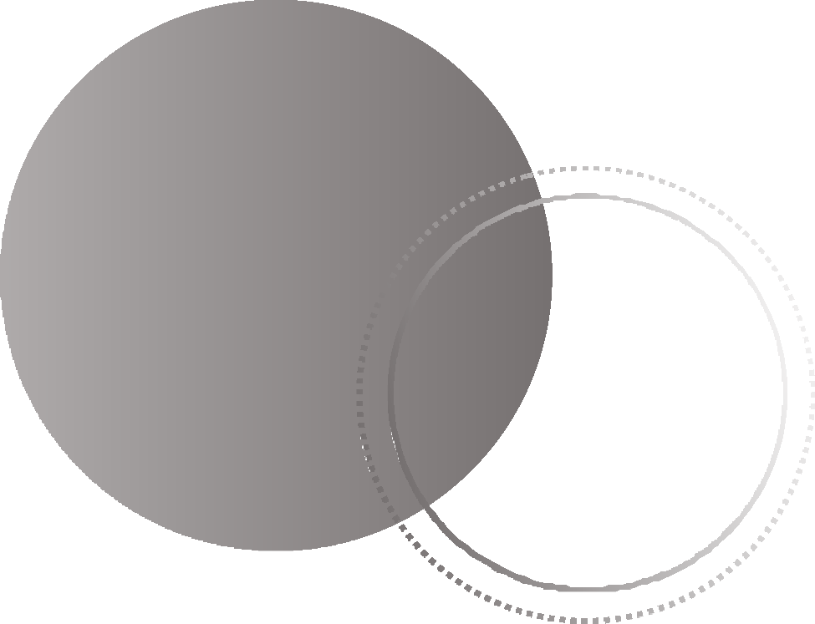

IPv4 Address Space
Outline
Classless and Classful Addressing

Slide 3
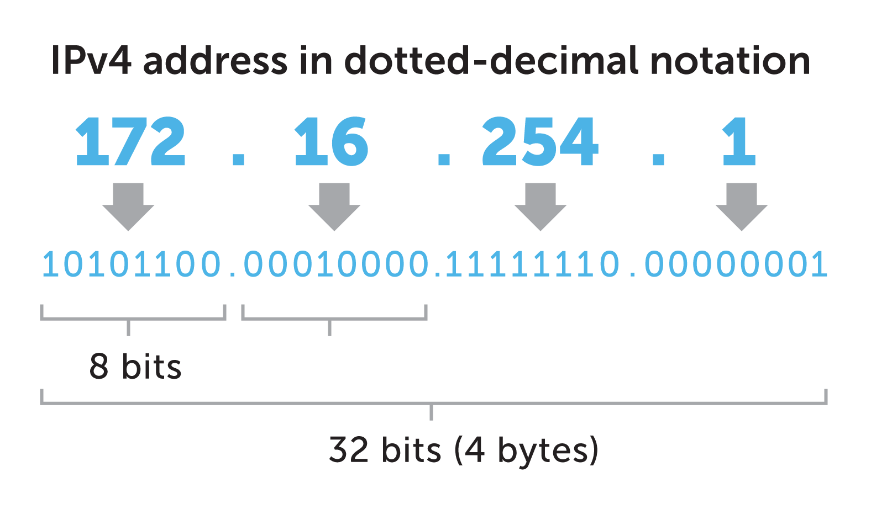
address that uniquely and
An IPv4 address is a 32-bit
universally defines the connection of a device
(for example, a computer or a router) to the Internet.
The address space of IPv4
is
₂32
or 4,294,967,296.
IPv4

Slide 4
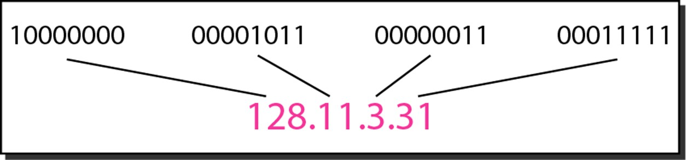
Dotted-Decimal notation and Binary Notation

Slide 5
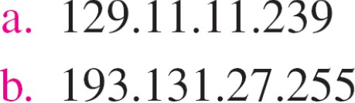
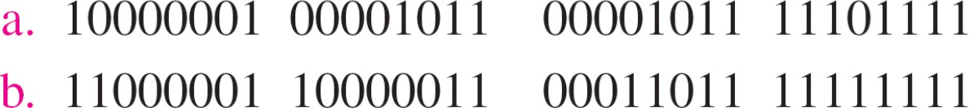
Change the following IPv4 addresses from binary notation to dotted-decimal notation.
Solution
We replace each group of 8 bits with its equivalent
decimal number and add dots for separation.

Slide 6
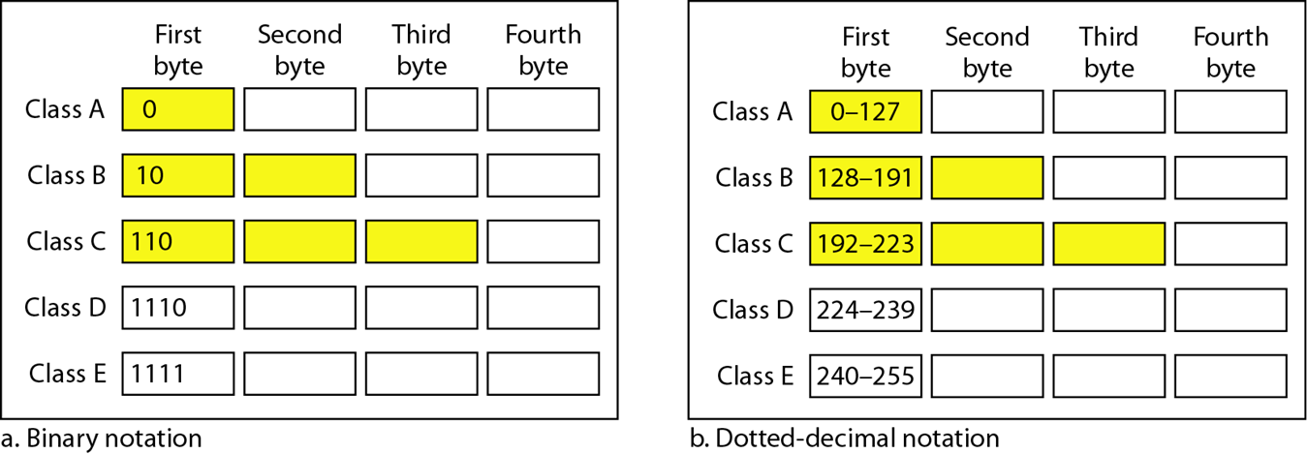
Classful Addressing
In classful addressing, the address space is divided into five classes:
A, B, C, D, and E

Slide 7
Example
Find the class of each address.
a. 00000001 00001011 00001011 11101111
b. 11000001 10000011 00011011 11111111
c. 14.23.120.8
d. 252.5.15.111
Solution
The first bit is 0. This is a class A address.
The first 2 bits are 1; the third bit is 0. This is a class C address.
The first byte is 14; the class is A.
The first byte is 252; the class is E.

Slide 8
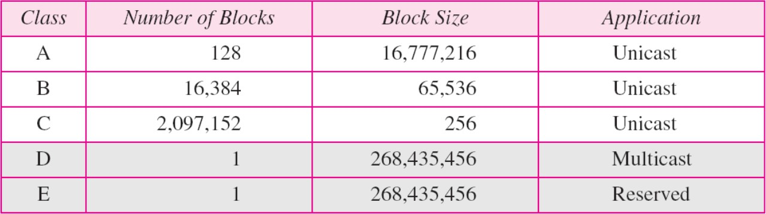
Classful Address Block Size

Slide 9
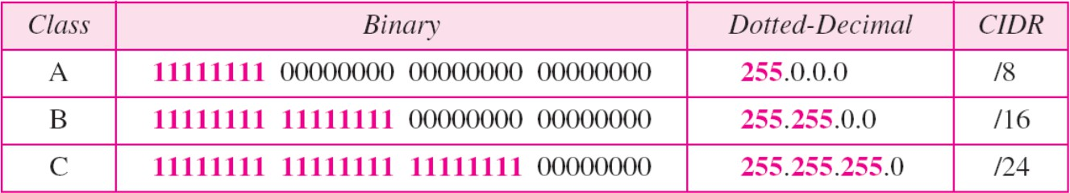
Default Masks for Classful Addressing

Slide 10

addresses can be defined as x.y.z.t /n in which x.y.z.t defines one of the addresses and the /n defines the mask.
In IPv4 addressing, a block of
CIDR (Classless Inter-Domain Routing) Notation
The first address in the block can be found by setting the rightmost 32 − n bits to 0s.
The last address in the block can be
found by setting the rightmost 32 − n bits to 1s.

Slide 11

Example
* Same example is referenced in next three slides
A block of addresses is granted to a small organization. We know that one of the addresses is 205.16.37.39/28. What is the first and last address in the block?
Solution: Step 1: /28 prefix means:28 bits for network4 bits for hostsTotal addresses = 24=1624=16 addresses per blockSo the block size is 16 addresses. Step 2: Find the network blockBlocks of 16 in the last octet increment by 16: 0–15 16–31 32–47 48–63...Since 39 falls between 32 and 47, the block is:205.16.37.32 – 205.16.37.47
The binary representation of the given address is 11001101 00010000 00100101 00100111
If we set 32−28 rightmost bits to 0, we get
11001101 00010000 00100101 0010000 or 205.16.37.32.
The binary representation of the given address is
11001101 00010000 00100101 00100111
If we set 32 − 28 rightmost bits to 1, we get
11001101 00010000 00100101 00101111 or 205.16.37.47

Slide 12
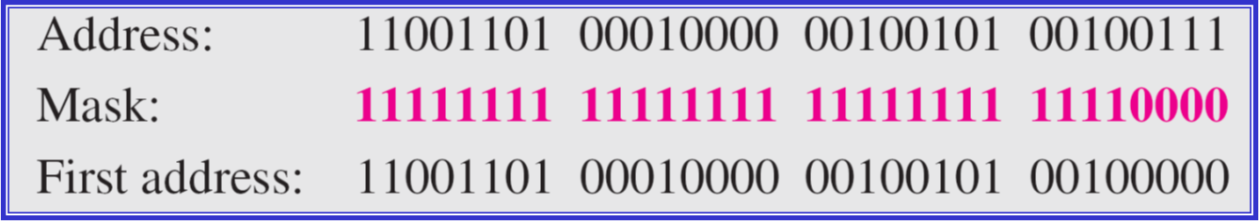
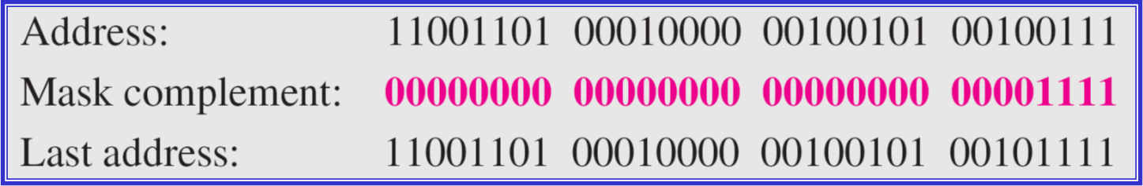
First and Last Address: AND/OR Operations
The first address can be found by ANDing the given addresses with the mask
The last address can be found by ORing the given addresses with the complement
of the mask.

Slide 13
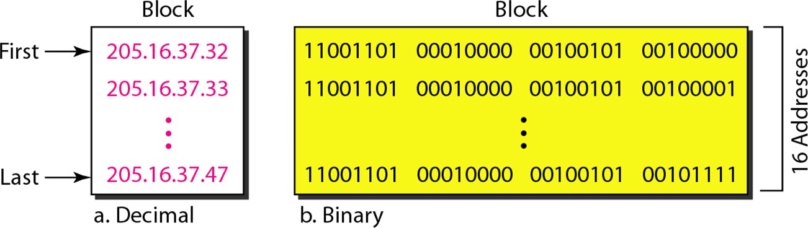
Network configuration for the block 205.16.37.32/28

Slide 14
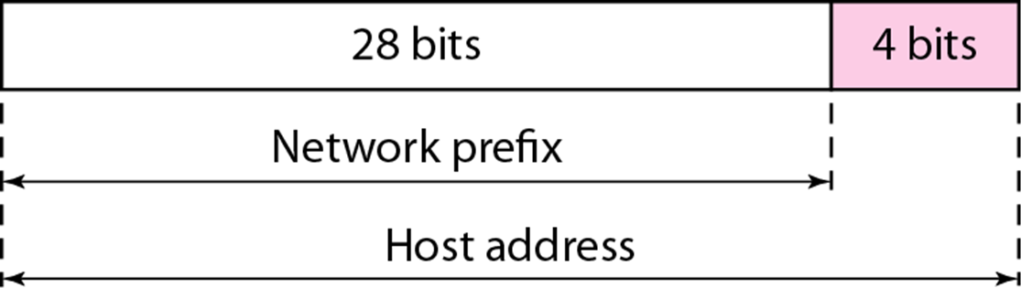
Note
The number of addresses in the block can be found by using the formula 2^{32−n}.
The
first address in a used as the
to any device; network address that represents the
block is normally not assigned
it is
organization
to the rest of the world.
Each address in the block can be considered as a two-level hierarchical structure: the leftmost n bits (prefix) define the network; the rightmost 32 − n bits define the host.

Slide 15

How Do You Get IPs?
IP address ranges controlled by IANA
Internet Assigned Number Authority Roots go back to 1972, ARPANET, UCLA Today, part of ICANN
IANA grants IPs to regional authorities
ARIN (American Registry of Internet Numbers) may grant you a range of IPs You may then advertise routes to your new IP range
There are now secondary markets, auctions, …

Slide 16
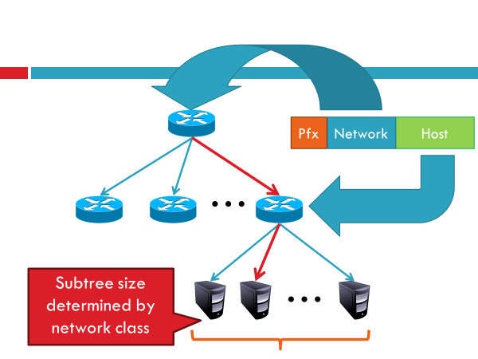
Classless Addressing: The Two Level Hierarchy

Slide 17
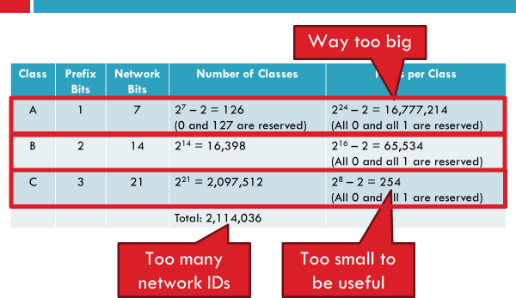
Classless Addressing: Class Sizes and Issues

Slide 18
Problem: Need to break up
large A and B classes
Solution: add another layer to the hierarchy
From the outside, appears to be a single network
Only 1 entry in routing tables
Internally, manage multiple subnetworks
Split the address range using
a subnet mask
Classless Addressing: Subnets

Slide 19
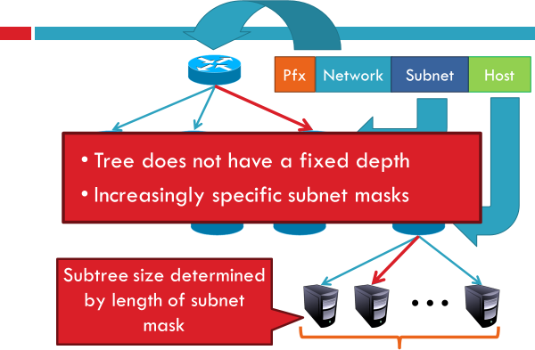
Classless Addressing: N-Level Subnet Hierarchy

Slide 20
Classless Addressing: Subnetting Examples

Slide 21

Thank You

